Slide 1

A gamified introduction to Python Programming Lecture 13 Text files handling and processing
Matthieu DE MARI – Singapore University of Technology and Design

Slide 2

Outline (Chapter 13)
What is a file handle?
What are opening modes for files?
How to read and write strings to a text file?
Practice

Slide 3
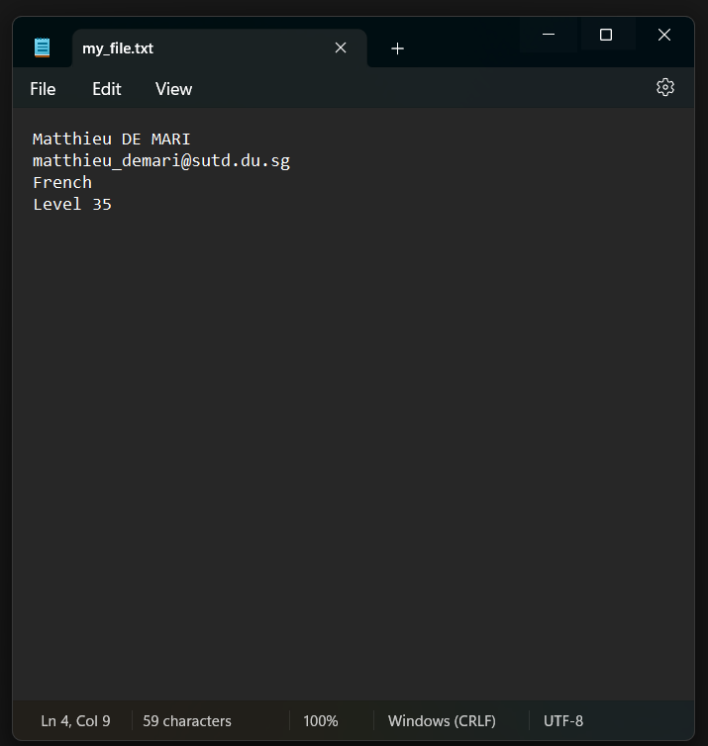
Text files
Definition (text files):
A text file is a file that contains text in plain string format. It is often saved using the .txt file format extension.
It is possible to open and read the content of a text file using a simple notepad/text editor.
Files that cannot be read with a simple text editor, require advanced operations (e.g. docx, pdf, etc.)

Slide 4
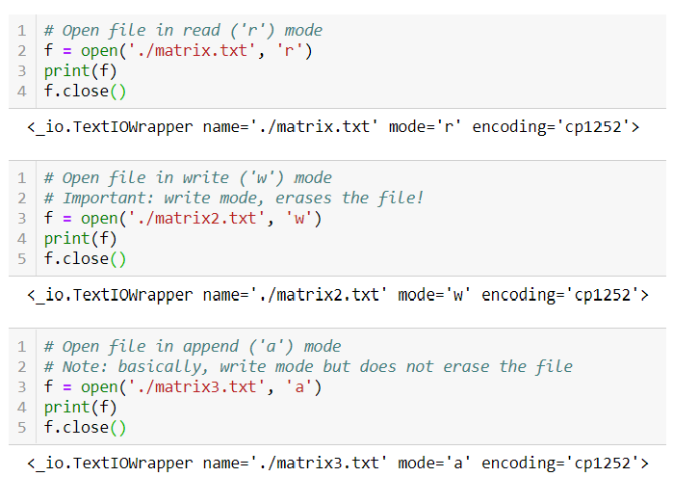
Opening a text file in Python
You can open a text file in Python, using the open() function.
It creates a file handler f,
Using the file name specified (Here “./matrix.txt” means there should be a text file with name matrix.txt in the same location of the Python notebook/file.)
Once done manipulating the file, remember to close it using the f.close() operation.

Slide 5
Opening a text file in Python
The f.open() method also expects a file reading/writing mode:
Read (‘r’): Opens the file but only allows Python to read content.
Write (‘w’): Opens the file but only allows Python to write content. Also erases the content of the file!
Append (‘a’): Opens the file but only allows Python to write content. Does not erase.

Slide 6
Opening a text file in Python
More advanced modes exist:
Read and write (‘r+’): Opens the file and allows all operations.
Read and write (‘w+’): Opens the file and allows all operations. Erases the content of the file!
There are also additional modes for, say, binary files, but these are simply out-of-scope for CTD.

Slide 7
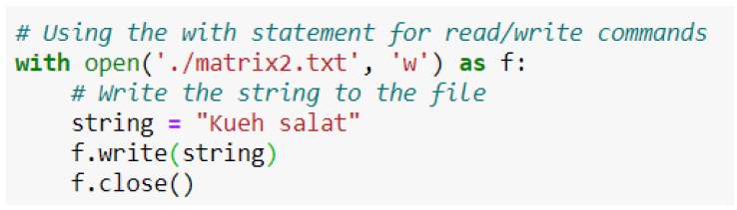
Open a text file in Python
Another formatting for opening a text file suggests to use the with statement upon opening the file.
It is used to indent the file input/outputs commands.
Improves the readability of your code (Preferred).

Slide 8
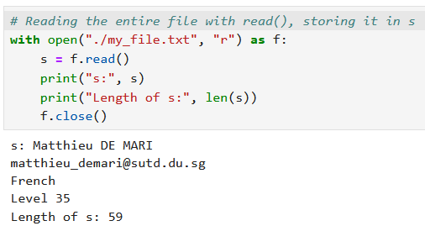
Reading a file with read()
Assuming the file has been opened with a valid reading mode, you can read its content with the read() function.
It is applied to the string handle f.
If no argument given, read everything in the file and store it in a string.

Slide 9
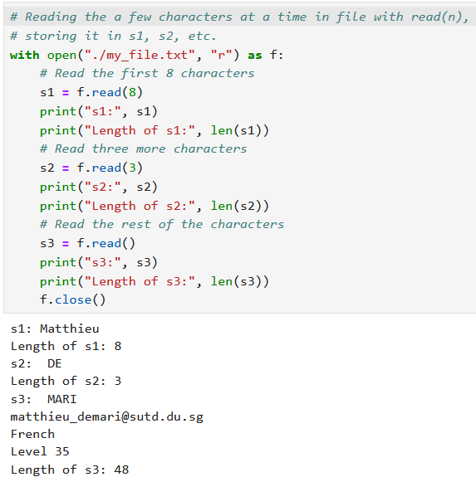
Reading a file with read()
Character-wise and multiple readings with read().
If an argument n is given to the read() function, read n characters from the file.
If successive reads, keep on reading the file, going from the position where the previous read ended.
First read, begins at the first character in the file.

Slide 10
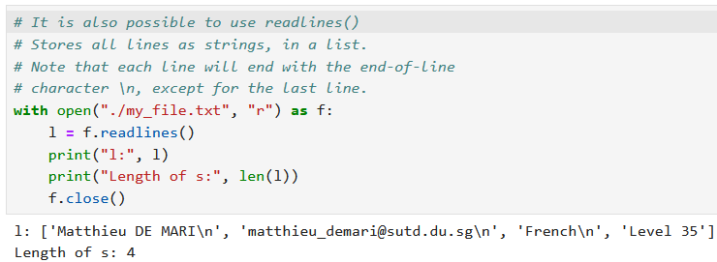
Reading a file with readlines()
It is also possible to read all lines at once with readlines().
It simply produces a list of strings, containing each line in the file.
Note that each line ends with the end-of-line character \n, except for the last line. If needed, slicing or strip() string method to remove it.

Slide 11
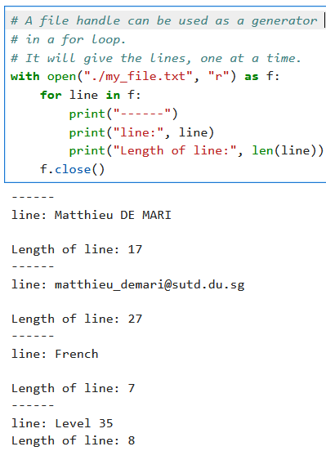
For loop with a file handle
It is possible to use a file handle as a generator in a for loop.
The iteration variable will read each line, one at a time.
This would be equivalent to replacing f with f.readlines() in the for loop definition.

Slide 12
Reminder on split() and strip()
The string method offered two methods that can help:
The strip() method removes characters at the beginning and the end of a string. When no argument is passed, it removes extra spaces and end-of-line markers \n.
The split() method separates a string into a list of strings using a specified separator. When no argument is passed, it uses spaces as separators.
Refer to Lesson 4 materials if you need more details!

Slide 13
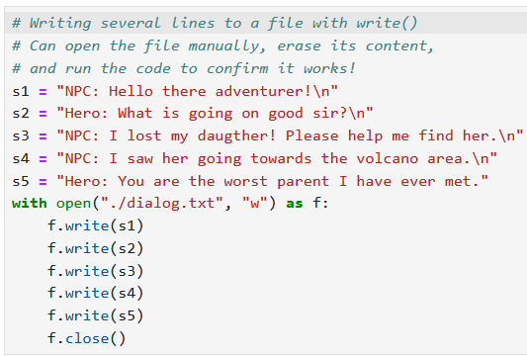
Writing to a file with write()
Similarly, assuming we have opened a file in valid write mode
We can write strings to text files using the write() method.
Successive write will start writing where the previous write stopped. Same idea as in read().

Slide 14
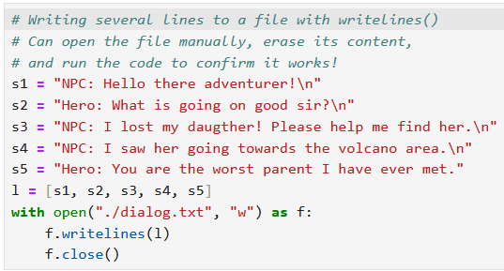
Writing to a file with writelines()
Similarly, assuming we have opened a file in valid write mode
We can write strings to text files using the write() method.
Successive write will start writing where the previous write stopped. Same idea as in read().
You can also write multiple lines stored in a list, at once, with the writelines() function.

Slide 15
Writing to a file with writelines()
Similarly, assuming we have opened a file in valid write mode
We can write strings to text files using the write() method.
Successive write will start writing where the previous write stopped. Same idea as in read().
You can also write multiple lines stored in a list, at once, with the writelines() function.
Reading and writing in files can be useful for your projects if:
You need a save file system (saving the progress of your user/player)
You need to keep track of a leaderboard with best scores
You need to centralize data somewhere and save it for future use (poor man’s database).
Etc.

Slide 16

A friendly reminder to RTFM
As usual, many more operations on text files, so RTFM!: https://docs.python.org/3/library/pathlib.html#reading-and-writing-files

Slide 17
Conclusion (Chapter 13)
What is a file handle?
What are opening modes for files?
How to read and write strings to a text file?
Practice

Slide 18



Please download and install the Slido app on all computers you use
What will be printed?
ⓘ Start presenting to display the poll results on this slide.

Slide 19
Please download and install the Slido app on all computers you use
What will appear in the output.txt file?
ⓘ Start presenting to display the poll results on this slide.

